Slide 1
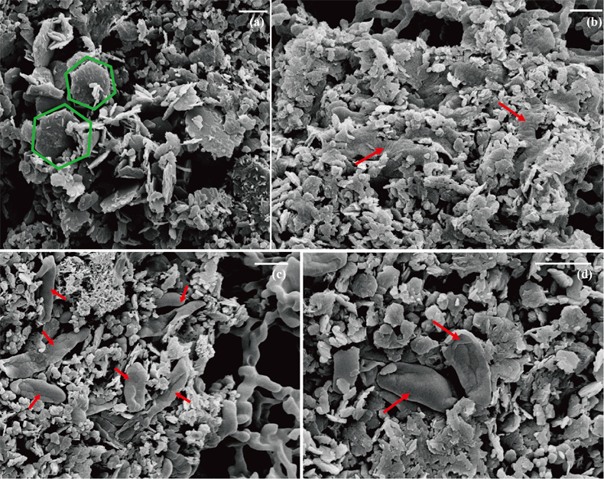
Han et al.
Oxidation of green rust by anoxygenic phototrophic Fe(II)-oxidising bacteria
Figure 1 Scanning electron microscopy (SEM) images of (a) GR_SW2 starting material, (b) SW2 culture suspension with GR, and (c,d) TIE-1 culture suspension with GR after 13 days cultivation. All scale bars in figures are 1 μm. The green hexagons are GR. The red arrows point to the cells.
© 2020 The Authors
Published by the European Association of Geochemistry
under Creative Commons License CC BY-NC-ND.
Han et al. (2020) Geochem. Persp. Let. 12, 52-57 | doi: 10.7185/geochemlet.2004
Notes:
Figure 1 Scanning electron microscopy (SEM) images of (a) GR_SW2 starting material, (b) SW2 culture suspension with GR, and (c,d) TIE-1 culture suspension with GR after 13 days cultivation. All scale bars in figures are 1 μm. The green hexagons are GR. The red arrows point to the cells.

