Slide 1
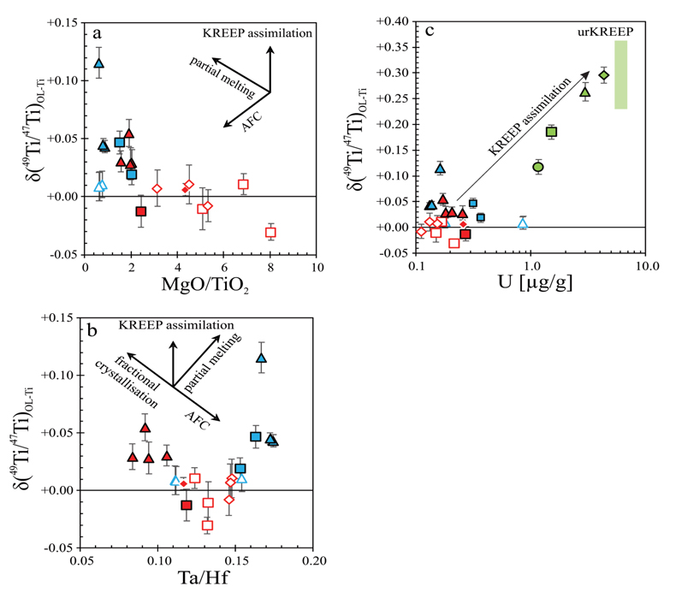
Kommescher et al.
Unravelling lunar mantle source processes via the Ti isotope composition of lunar basalts
Figure 2 Plots of (a) δ⁴⁹Ti vs. MgO/TiO₂, (b) δ⁴⁹Ti vs. Ta/Hf and (c) δ⁴⁹Ti vs. U that can be used to discriminate between processes leading to variations in δ⁴⁹Ti. Symbols are the same as in Figure 1, black arrows indicate the direction in which a process would influence the values along y- and x-axes. Partial melting assumes the presence of ilmenite in the source, fractional crystallisation always implies fractional crystallisation of ilmenite. AFC implies the assimilation of an IBC component during ilmenite-free fractional crystallisation of a low-Ti magma. (b) The estimated Ta/Hf value of urKREEP is ~0.11 (Warren and Taylor, 2014). (c) Contamination by urKREEP (coloured arrow), would imply higher U contents (not observed). urKREEP is based on our first model (see Supplementary Information).
© 2020 The Authors
Published by the European Association of Geochemistry
under Creative Commons License CC BY-NC-ND.
Kommescher et al. (2020) Geochem. Persp. Let. 13, 13-18 | doi: 10.7185/geochemlet.2007
Notes:
Figure 2 Plots of (a) δ⁴⁹Ti vs. MgO/TiO₂, (b) δ⁴⁹Ti vs. Ta/Hf and (c) δ⁴⁹Ti vs. U that can be used to discriminate between processes leading to variations in δ⁴⁹Ti. Symbols are the same as in Figure 1, black arrows indicate the direction in which a process would influence the values along y- and x-axes. Partial melting assumes the presence of ilmenite in the source, fractional crystallisation always implies fractional crystallisation of ilmenite. AFC implies the assimilation of an IBC component during ilmenite-free fractional crystallisation of a low-Ti magma. (b) The estimated Ta/Hf value of urKREEP is ~0.11 (Warren and Taylor, 2014). (c) Contamination by urKREEP (coloured arrow), would imply higher U contents (not observed). urKREEP is based on our first model (see Supplementary Information).

