Slide 1
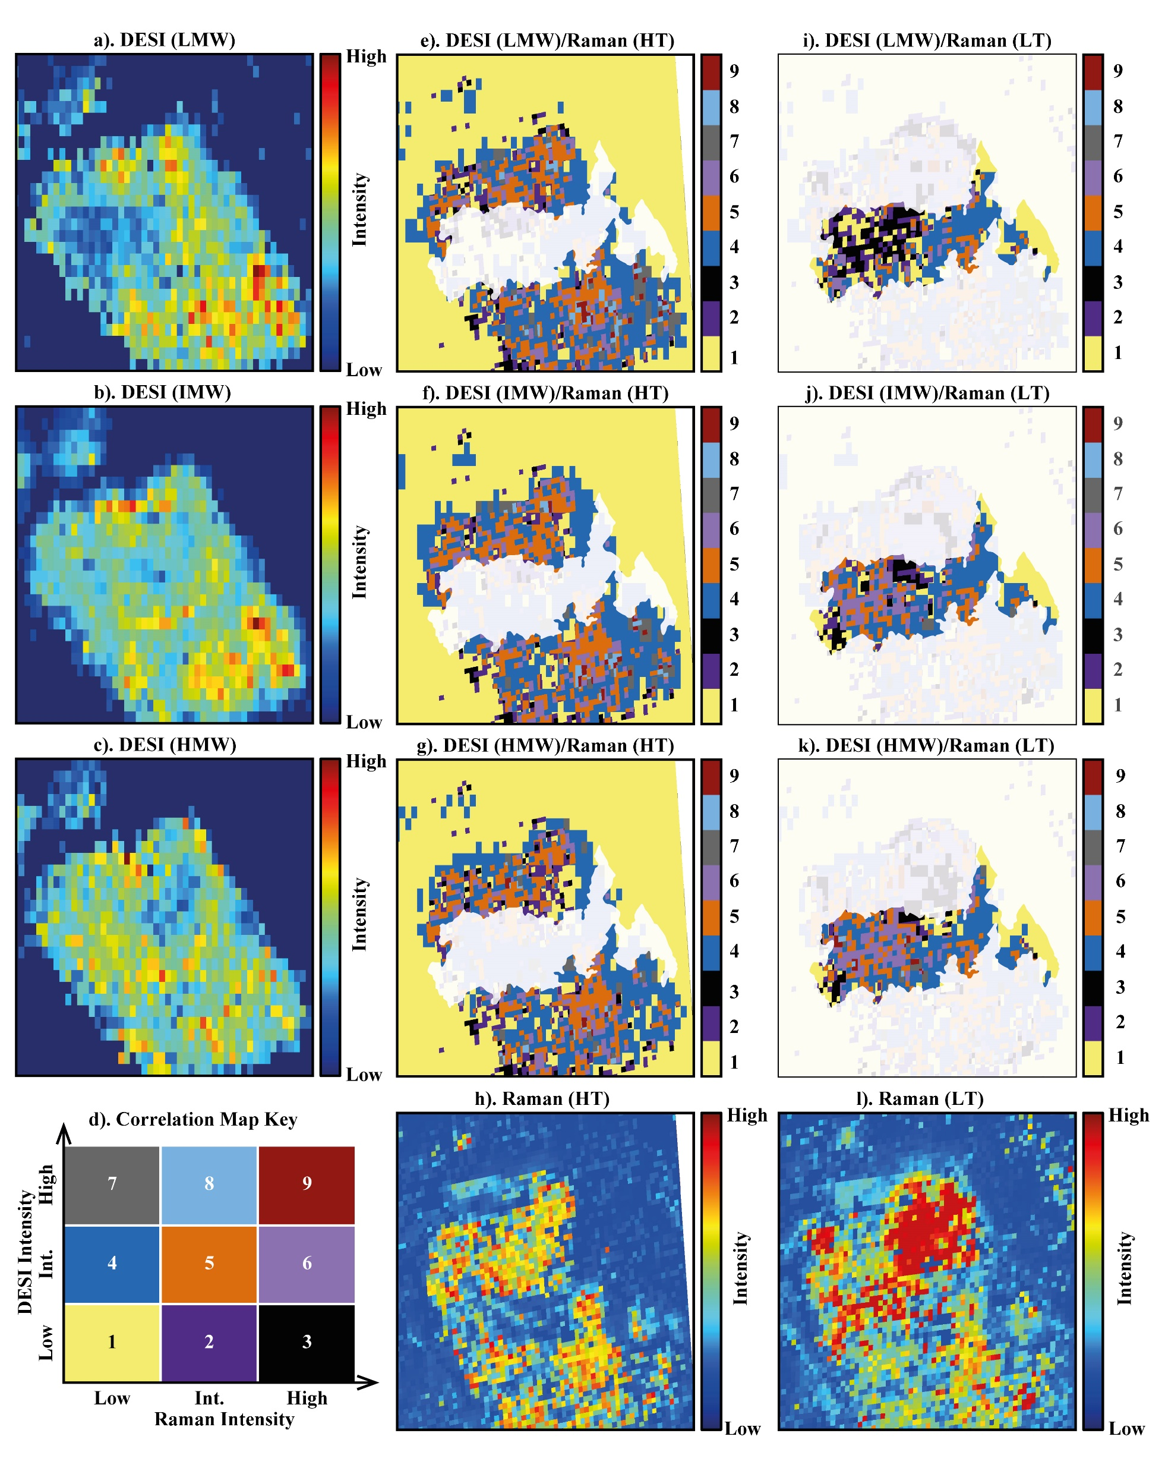
Potiszil et al.
Concentration of meteoritic free organic matter by fluid transport and adsorption
Figure 3 A compilation of DESI, Raman and correlation maps for selected alkylpyridine homologues. (a-c) DESI intensity maps for mass 136.11205, 178.15891 and 220.20580, respectively. Highest normalised intensity is 2.17 x 10⁻³, 5.44 x 10⁻² and 2.58 x 10⁻³, respectively. (d) A schematic outlining the criteria for the generation of DESI vs. Raman correlation maps. (e-g) Correlation maps showing the similarity between a given DESI and high topography (HT) Raman map. (h) A Raman intensity map focused on high topography, for the interlayer/adsorbed water band (3000-3800 cm⁻¹). (i-k) Correlation maps showing the similarity between a given DESI and low topography (LT) Raman map. (l) As for h except focused on low topography. Note that for the correlation maps a partially transparent white mask has been used to highlight the high topography (top 40 µm) or low topography (below top 40 µm).
© 2020 The Authors
Published by the European Association of Geochemistry
under Creative Commons License CC BY-NC-ND.
Potiszil et al. (2020) Geochem. Persp. Let. 13, 30-35 | doi: 10.7185/geochemlet.2010
Notes:
Figure 3 A compilation of DESI, Raman and correlation maps for selected alkylpyridine homologues. (a-c) DESI intensity maps for mass 136.11205, 178.15891 and 220.20580, respectively. Highest normalised intensity is 2.17 x 10⁻³, 5.44 x 10⁻² and 2.58 x 10⁻³, respectively. (d) A schematic outlining the criteria for the generation of DESI vs. Raman correlation maps. (e-g) Correlation maps showing the similarity between a given DESI and high topography (HT) Raman map. (h) A Raman intensity map focused on high topography, for the interlayer/adsorbed water band (3000-3800 cm⁻¹). (i-k) Correlation maps showing the similarity between a given DESI and low topography (LT) Raman map. (l) As for h except focused on low topography. Note that for the correlation maps a partially transparent white mask has been used to highlight the high topography (top 40 µm) or low topography (below top 40 µm).

