Slide 1
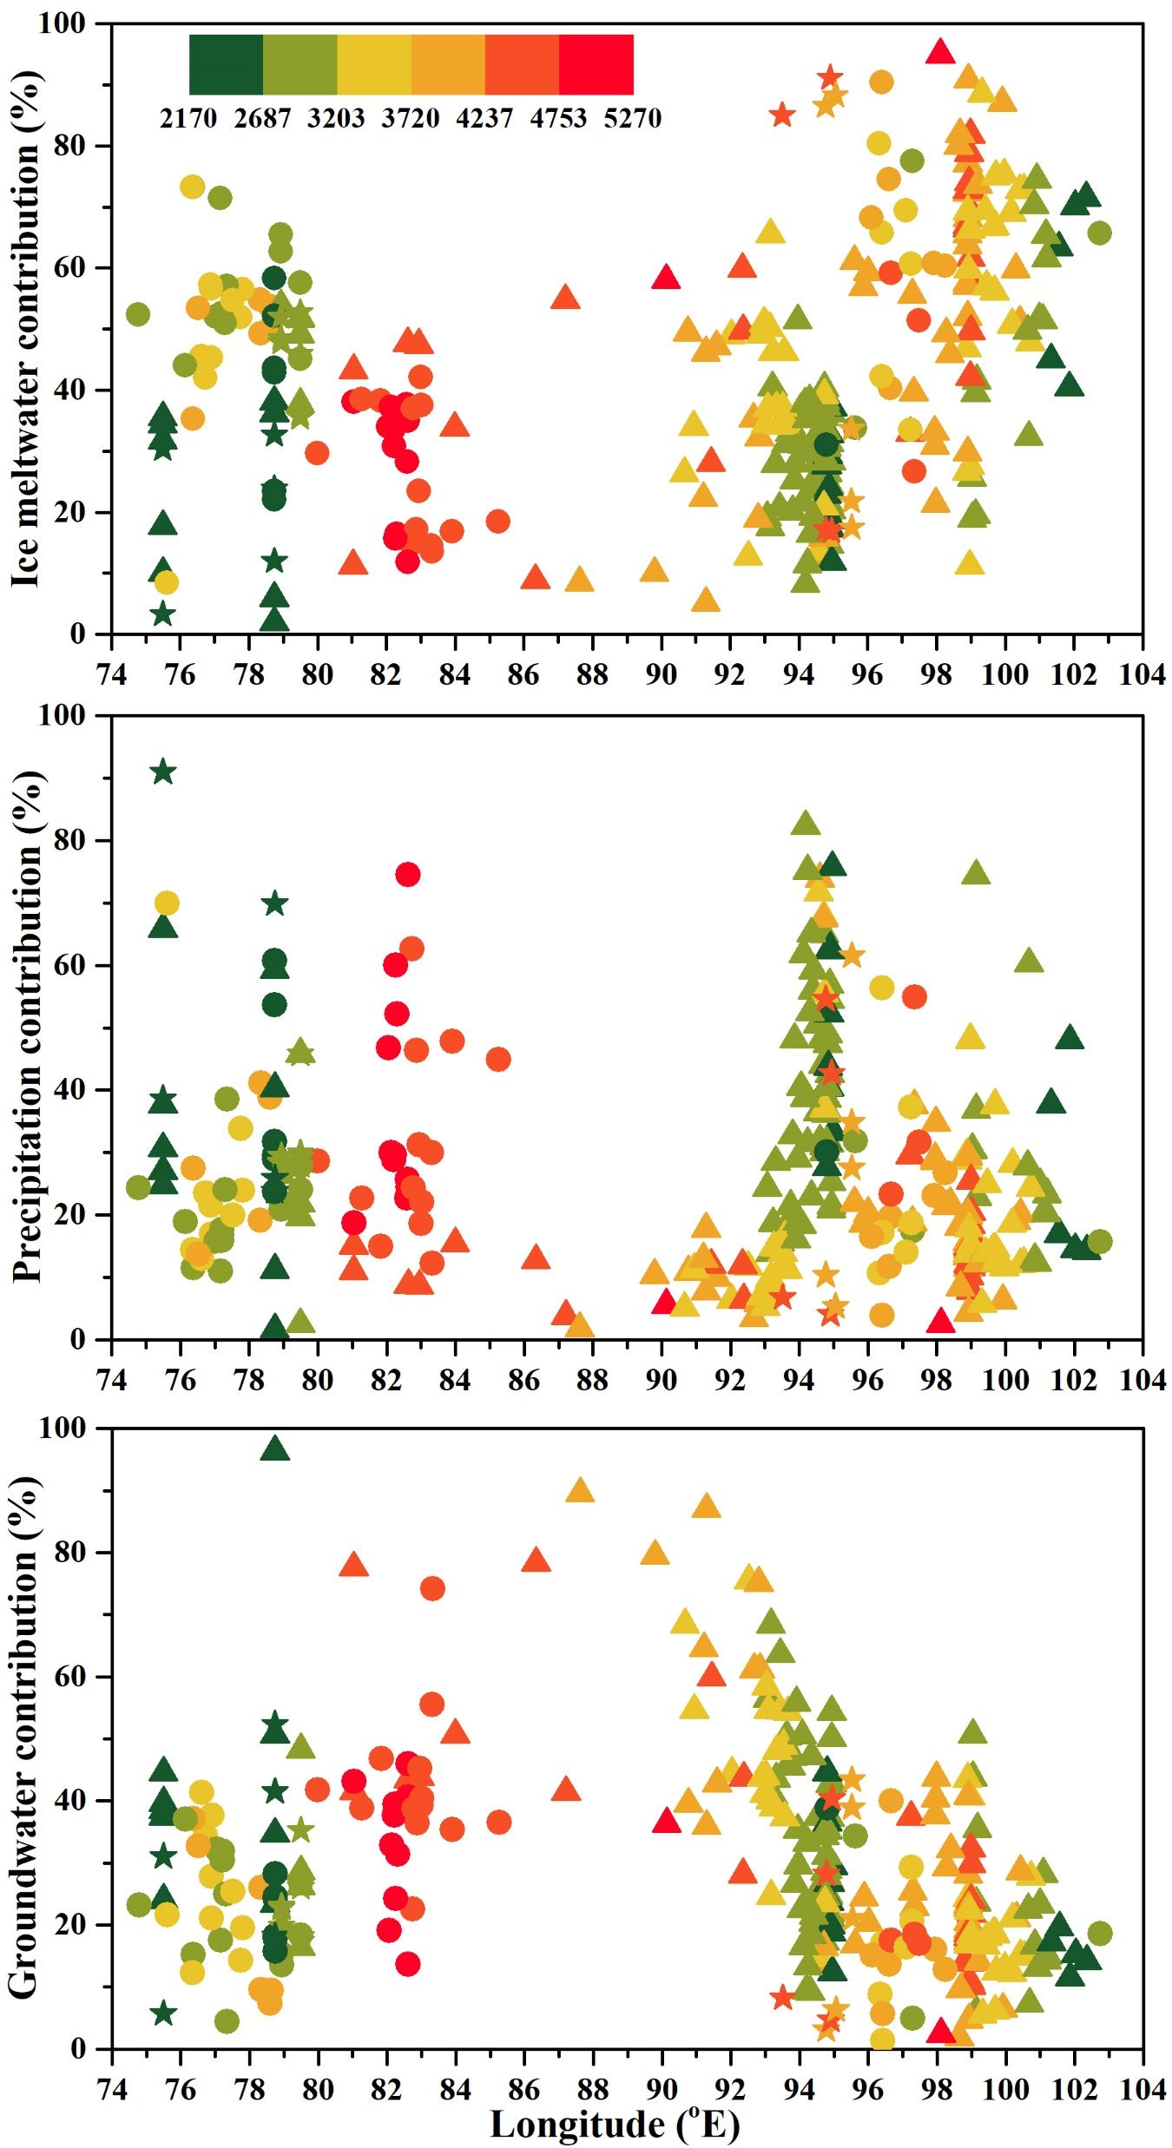
Boral and Sen
Tracing ‘Third Pole’ ice meltwater contribution to the Himalayan rivers using oxygen and hydrogen isotopes
Figure 3 Calculated relative fractions (%) of ice meltwater, precipitation, and groundwater to the total streamflow of rivers Indus, Ganges, Brahmaputra, Salween, Mekong and Yangtze in pre-monsoon (triangles), monsoon (circles) and post-monsoon (stars). The colour represents elevation in metres a.m.s.l.
© 2020 The Authors
Published by the European Association of Geochemistry
under Creative Commons License CC BY-NC-ND.
Boral and Sen (2020) Geochem. Persp. Let. 13, 48-53 | doi: 10.7185/geochemlet.2013
Notes:
Figure 3 Calculated relative fractions (%) of ice meltwater, precipitation, and groundwater to the total streamflow of rivers Indus, Ganges, Brahmaputra, Salween, Mekong and Yangtze in pre-monsoon (triangles), monsoon (circles) and post-monsoon (stars). The colour represents elevation in metres a.m.s.l.

